Slide 1
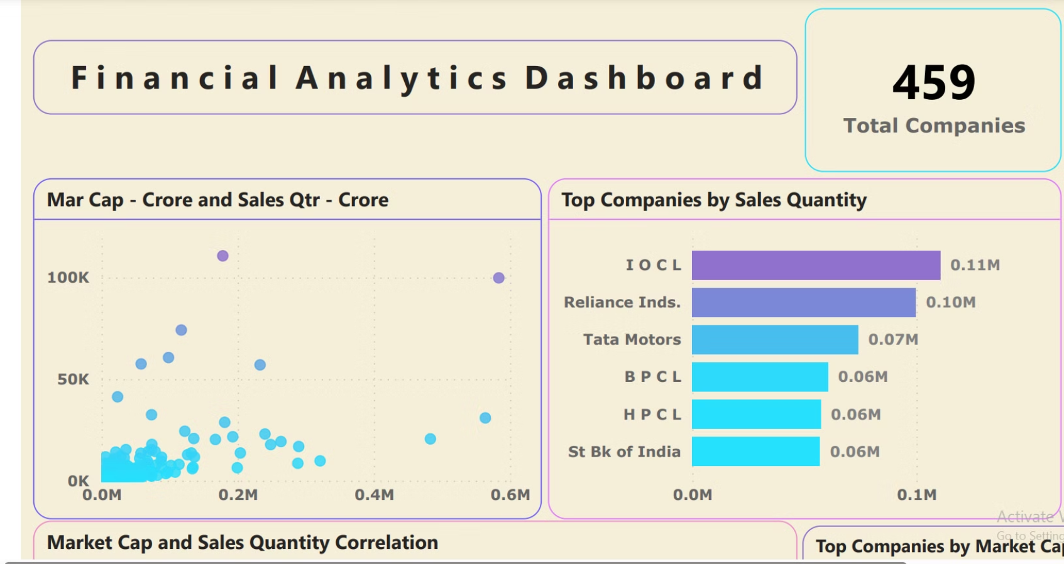


Slide 2

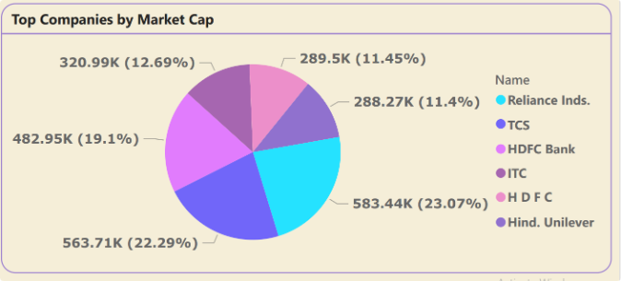
Total Market Capitalization
$13.25M Total
459 Total Companies
$1.75M Total Sales
The total market capitalization of the companies analyzed is a staggering $13.25 million, showcasing the immense financial power of the Indian corporate landscape.
The dashboard covers data from a total of 459 companies, providing a broad and representative sample of the Indian market.
The combined quarterly sales of these companies amount to an impressive $1.75 million, highlighting the robust financial performance of the top players in the market.

Slide 3

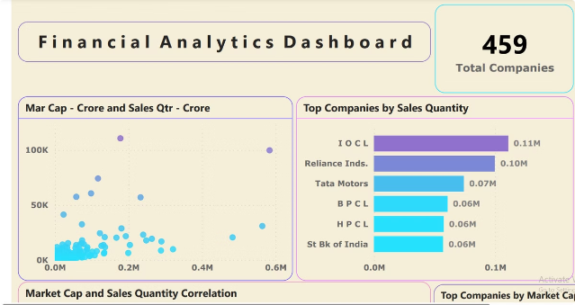
Financial Analytics Dashboard
Explore key financial metrics and performance indicators of top companies in the Indian market through interactive visualizations and data analysis on our dashboard.
Gain insights into market trends, company performance, and financial health through dynamic charts and graphs that simplify complex financial data.
Access detailed reports and analysis to make informed decisions, track market movements, and identify investment opportunities based on reliable financial data.

Slide 4
Top Companies by Sales
Reliance Industries
TCS, HDFC Bank, ITC, HDFC
Unilever
Reliance Industries leads the pack with a staggering 19.1% market share, showcasing its dominance in the Indian market.
Unilever, a global consumer goods giant, also makes an appearance in the top companies by sales, highlighting its significant presence in the Indian market.
These household names round out the top companies by sales, demonstrating the strength and diversity of the Indian corporate landscape.

Slide 5

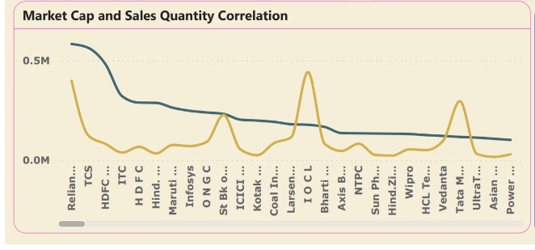
Top Companies by Market Cap
1
Adani Ports
Adani Ports leads the pack with an average market capitalization of $81,781.89 crore, showcasing its dominance in the Indian port and logistics sector.
2
Reliance Industries
Reliance Industries, the conglomerate with diverse business interests, boasts an average market cap of $48,295 crore, cementing its position as a powerhouse in the Indian market.
3
HDFC Bank
HDFC Bank, a leading private sector bank, maintains a strong market presence with an average market capitalization of $31,983.33 crore.

Slide 6
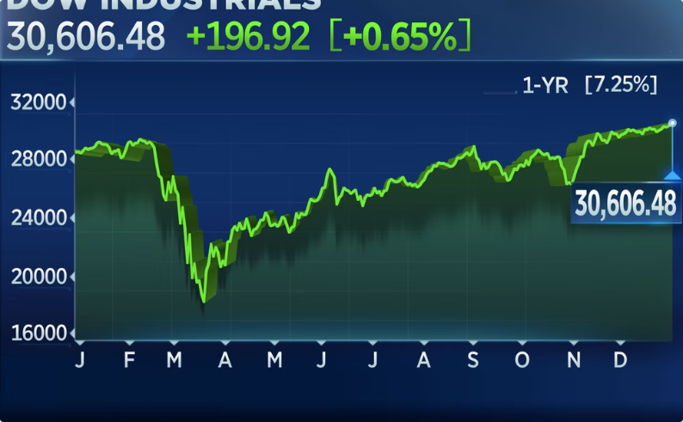

Market Cap and Sales Correlation
Positive Correlation
Driving Growth
The dashboard reveals a positive correlation between market capitalization and sales quantity, indicating that companies with higher sales tend to have a larger market presence and valuation.
This correlation suggests that strong sales performance is a key driver of market capitalization, as investors recognize the financial strength and growth potential of these companies.

Slide 7

ABB India
1
Market Cap: $31,983.33 Crore
ABB India, a leading provider of industrial automation and electrification solutions, boasts a strong market capitalization of $31,983.33 crore, reflecting its dominant position in the Indian market.
2
Diverse Product Portfolio
The company's diverse product portfolio, ranging from power grids to robotics and automation, has enabled it to cater to a wide range of industries and maintain its competitive edge.
3
Innovative Solutions
ABB India's focus on developing innovative solutions, leveraging the latest technologies, has been a key driver of its success and market leadership in the Indian industrial landscape.

Slide 8
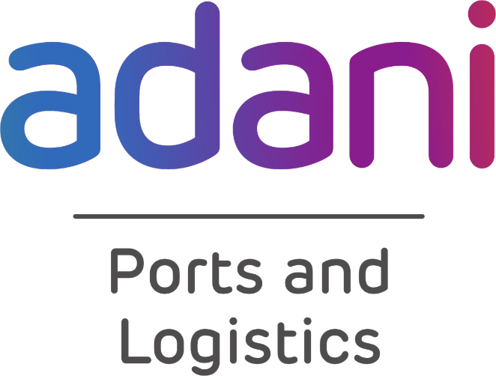



Adani Ports and Special Economic Zone
Logistics Powerhouse
Adani Ports and Special Economic Zone has emerged as a logistics powerhouse in India, with its extensive network of ports and terminals strategically located across the country.
Diversified Operations
The company's diversified operations, encompassing cargo handling, logistics services, and special economic zones, have contributed to its impressive market capitalization of $81,781.89 crore.
Driving Economic Growth
Adani Ports' role in facilitating trade and commerce has made it a key player in driving economic growth and development in India, further solidifying its position as a market leader.

Slide 9
Aditya Birla Group
Aditya Birla Capital
Aditya Birla Fashion and Retail
Aditya Birla Nuvo
Aditya Birla Capital, the financial services arm of the Aditya Birla Group, boasts a market capitalization of $36,215.92 crore, reflecting its strong presence in the Indian financial sector.
Aditya Birla Nuvo, with a market cap of $24,592.21 crore, is a conglomerate with diverse business interests, further demonstrating the Aditya Birla Group's strong presence across various sectors in India.
Aditya Birla Fashion and Retail, with a market cap of $11,718.17 crore, is a leading player in the Indian apparel and retail industry, showcasing the group's diversified business interests.

Slide 10




Adani Group
Adani Power
Adani Transmission
Adani Enterprises
Adani Power, with a market capitalization of $12,091.50 crore, is a leading player in the Indian power generation sector, showcasing the Adani Group's diversification into the energy industry.
Adani Transmission, with a market cap of $21,677.26 crore, is a key player in the Indian power transmission and distribution sector, further strengthening the Adani Group's foothold in the energy value chain.
Adani Enterprises, the flagship company of the Adani Group, boasts a market capitalization of $21,776.04 crore, reflecting the group's diversified business interests and its position as a major conglomerate in India.

Slide 11

Advanta
Market Cap
$6,742.41 Crore
Sales
Not Provided
Industry
Agribusiness
Key Products
Seeds, Crop Protection, Crop Nutrition
Advanta, a leading player in the Indian agribusiness sector, boasts a market capitalization of $6,742.41 crore. The company's focus on providing innovative seeds, crop protection, and crop nutrition solutions has contributed to its strong market presence and financial performance.

Slide 12
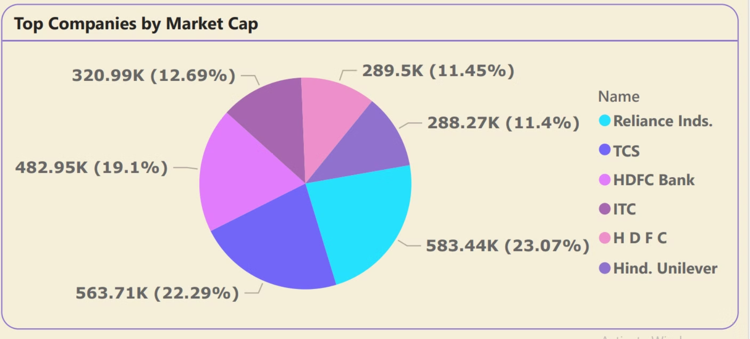

Slide 13
THANKS

